Slide 1

Angular Part 9 – Template Driven Forms Wednesday, January 31, 2024

Slide 2


Agenda
Template Driven Forms
Multi-Fields Validation

Slide 3
Template Driven Forms
Forms can be design as Template Driven Forms or Reactive Forms
Template Driven Forms are based on template directives
Reactive Forms are based on programmatically at the level of the component
Template Driven Forms
Forms Design
Reactive Forms

Slide 4
Template Driven Forms
[ngModel] tells Angular that it is a FormControl and use property binding. The [] allows us to set default values when the form is created
Required indicates that the field cannot be empty
email tells Angular to validate this field to match the email pattern
<form (ngSubmit)="onSubmit(form)" #form="ngForm">
<div>
<div class="form-group">
Name: <input
class="form-control"
type="text"
[ngModel]
name="name"
required
#name="ngModel"/>
</div>
<div class="form-group">
email: <input
class="form-control"
type="text"
[ngModel]
name="email"
required
email
#email="ngModel"/>
<span class="help-block" *ngIf="!email.valid && email.touched">Please enter valid email</span>
</div>
</div>

Slide 5
Template Driven Forms using array
<div class="form-group" ngModelGroup="skills" #skillModelGroup="ngModelGroup">
<div class="container">
@for (skill of skills; track skill; let idx=$index) {
<div class="row">
<div class="col-sm-3">
skill <input
class="form-control"
type="text"
[(ngModel)]="skill.skill"
name="skill{{idx}}"
required
pattern="^.*$"/>
</div>
<div class="col-sm-4">
exp <input
class="form-control"
type="number"
[(ngModel)]="skill.exp"
name="exp{{idx}}"
required/>
</div>
</div>
}
</div>
</div>
<button class="btn btn-primary" (click)="onAddSkill()" type="button">AddSkill</button>
<button [disabled]="!form.valid"class="btn btn-primary" type="submit">Submit</button>
</form>
The example below shows how to use array in the template driven forms
pattern tells Angular to validate according to the provided regular expression

Slide 6
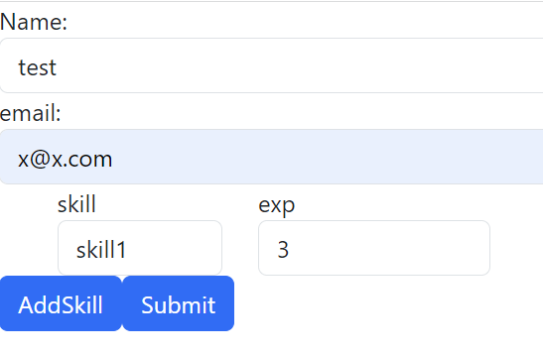
Template Driven Forms Set Default Value
export interface Skill {
skill: string
exp: number
}
@Component({
selector: 'app-root',
standalone: true,
imports: [CommonModule, RouterOutlet, FormsModule],
templateUrl: './app.component.html',
styleUrl: './app.component.css'
})
export class AppComponent implements AfterViewInit {
title = 'AngularPart9'
skills: Skill[] = []
@ViewChild('name') name!: NgModel
@ViewChild('skillModelGroup') skillModelGroup!: NgModelGroup
ngAfterViewInit (): void {
this.name.control.setValue('test')
}
onAddSkill (): void {
const skill: Skill = { skill: '', exp: 0 }
this.skills.push(skill)
}
onSubmit (form: NgForm): void {
for (const skill of this.skills) {
console.log(skill.skill, skill.exp)
}
}
}
Initialize name using ViewChild and set default value to ‘test’

Slide 7
Multi-Field Form Validation
Best approach to Multi-Field validation is using (ngSubmit) event handling such as match password between password entered and confirm password
passwordMissmatch is returned true if password and confirm password not matched
<form (ngSubmit)="onSubmitMatchPwd(matchPasswordForm)" #matchPasswordForm="ngForm">
<div class="form-group">
email: <input class="form-control"
type="text"
ngModel
name="emailField"
required
email
#emailField="ngModel" />
<span class="help-block" *ngIf="!emailField.valid && emailField.touched">Please enter valid email</span>
</div>
<div class="form-group">
password: <input class="form-control"
type="text"
ngModel
name="pwdField"
required
pattern="^.*$"
#pwdField="ngModel" />
<span class="help-block" *ngIf="!pwdField.valid && pwdField.touched">Please enter valid password</span>
</div>
<div class="form-group">
Confirm Password: <input class="form-control"
type="text"
ngModel
name="confirmPwdField"
required
pattern="^.*$"
#confirmPwdField="ngModel" />
<span class="help-block" *ngIf="!confirmPwdField.valid && confirmPwdField.touched && !confirmPwdField.errors?.['passwordMissmatch']">Please enter valid confirm password</span>
<span class="help-block" *ngIf="confirmPwdField.errors?.['passwordMissmatch']">Password is missmatched</span>
</div>
<button [disabled]="!matchPasswordForm.valid" class="btn btn-primary" type="submit">Submit</button>
</form>

Slide 8
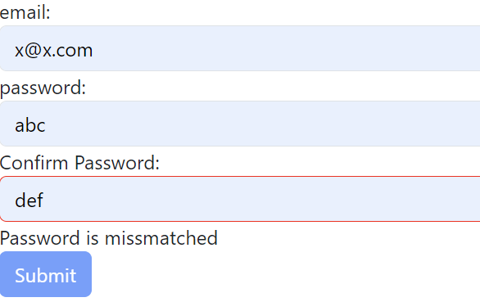
Multi-Field Form Validation
onSubmitMatchPwd setErrors to { passwordMissmatch : true }
Angular auto adds ng-invalid attribute to the field that is invalid
Angular also auto adds ng-touched attribute to the field that is touched
export class AppComponent implements AfterViewInit {
title = 'AngularPart9'
onSubmitMatchPwd (matchPasswordForm: NgForm): void {
const pwdControl = matchPasswordForm.controls['pwdField']
const confirmPwd = matchPasswordForm.controls['confirmPwdField']
if (pwdControl.value !== confirmPwd.value) {
confirmPwd.setErrors({ passwordMissmatch: true })
console.log(confirmPwd)
return
}
console.log('onSubmitMatchPwd successfully completed')
}
}
input.ng-invalid.ng-touched {
border : 1px solid red;
}

Slide 9

Thank you
Sonny Hoang
sthoang62@gmail.com

